Slide 1


INFO8065-Data Analytics Group Project
Group Members
Mritunjay Pargotra
Chinemerem Aduh (Neme)

Slide 2
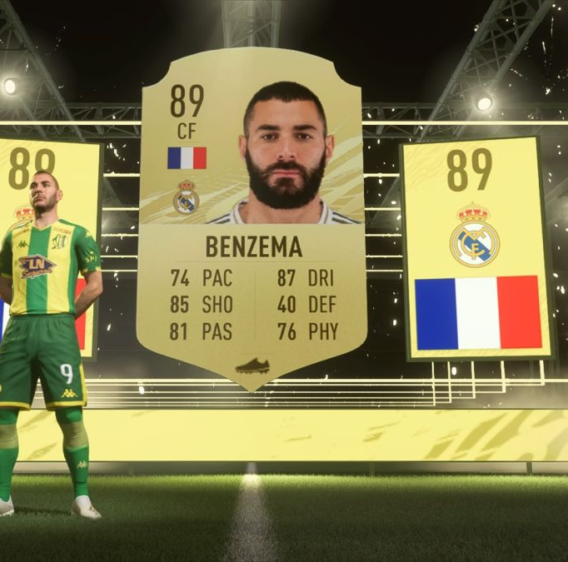
Introduction
This Fifa Player Dataset contains details of around 18000 fifa players and 92 features (columns) scraped from sofifa.com
The dataset column was cleaned and finally we came up with 64 columns
The dataset is based on individual player level
Acknowledgements
This dataset comes from https://data.world/raghav333/fifa-players

Slide 3

Contents
Project Name: Fifa Player Rating
About the Project
Project Beneficiary
Dataset Used for Analysis
Project Insights
End User Benefit of the Project
Challenges
Learnings
Conclusion

Slide 4

About the Project
This project will look to understand individual player abilities by analyzing each player’s feature.
By gaining insights on these player’s feature, a club manager could better manage the players to reach their maximum potential.

Slide 5

Project Beneficiary
The beneficiary of this project will be:
Club managers/coaches
FIFA gamers
Football talent scouts

Slide 6
Dataset Used for Analysis
Fifa Player’s Ratings : In this dataset, you will find tens of thousands of players from the FIFA dataset.
The dataset named ‘fifa_cleaned.csv’ file was extracted from Kaggle.com and used for the analysis.

Slide 7
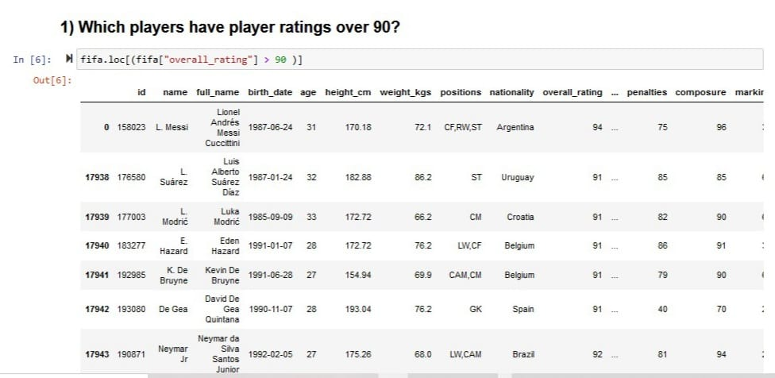
Project Insights
This insights shows about 8 players who were rated over 90 ability.

Slide 8
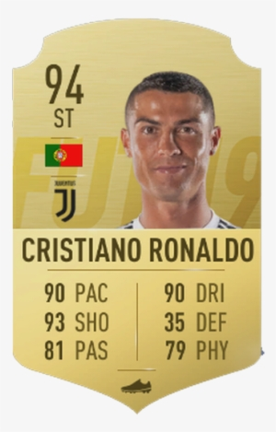
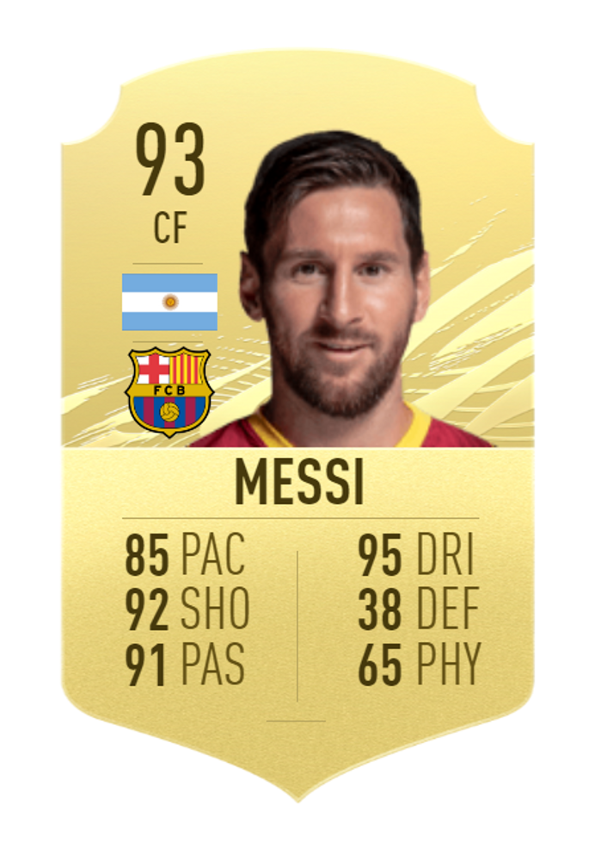
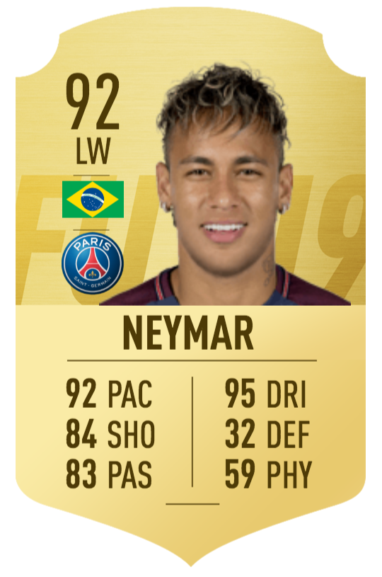
Project Insights
Insights: The three best players in the FIFA dataset.

Slide 9
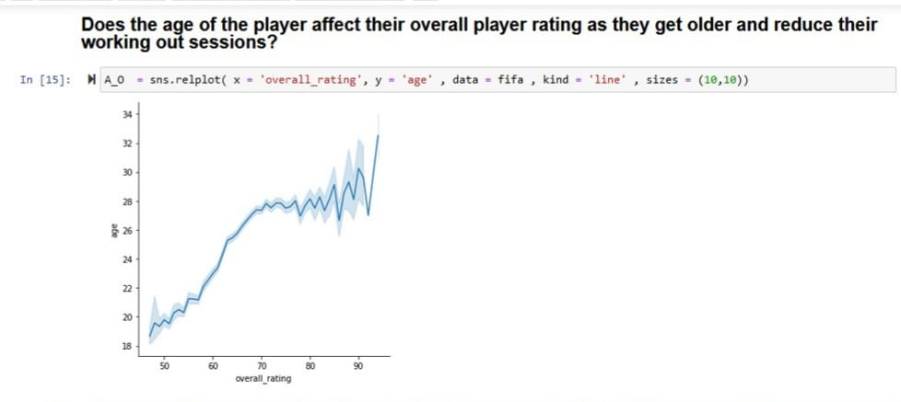
Project Insights
From the Insights, players aged 24 and below have lower ratings as they are yet to reach their full potential.
Where as, players aged 25 and 32 reaches their peak level thereby having a much better rating.

Slide 10
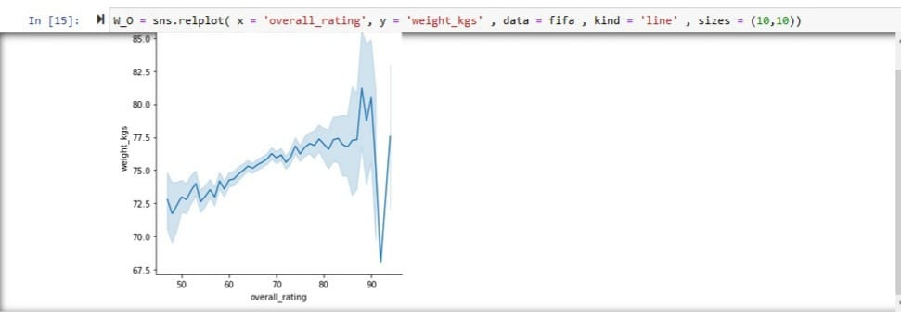
Project Insights
Insights: Players with 77.5 – 82.5 weight_kg have 80 – 90 ratings.
However, there are outliers for few players with weight below 75kg having about 90 ratings.

Slide 11
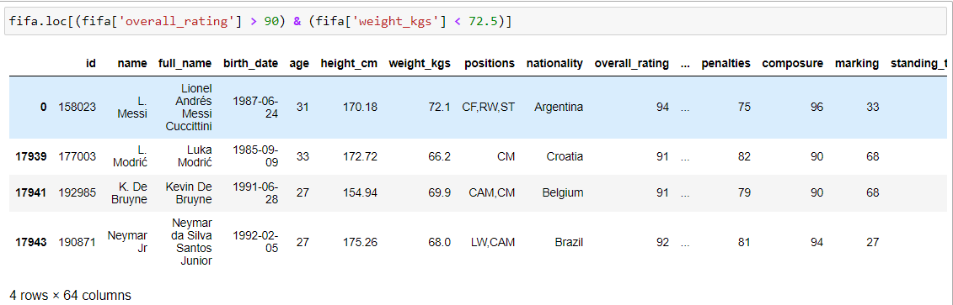
Project Insights
Insights: These outliers are shown above. Players like Lionel Messi, Luka Modric, Kevin De Bruyne and Neymar all have weight below 75kg and they are rated over 90.

Slide 12
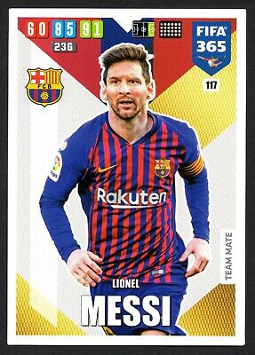
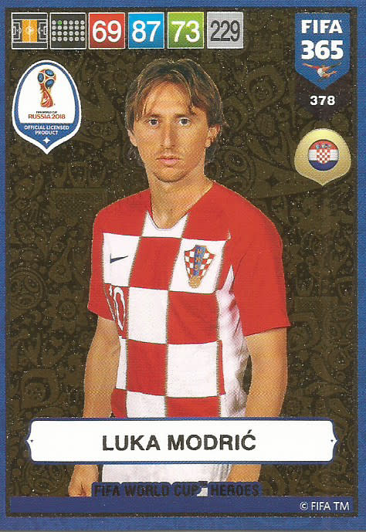
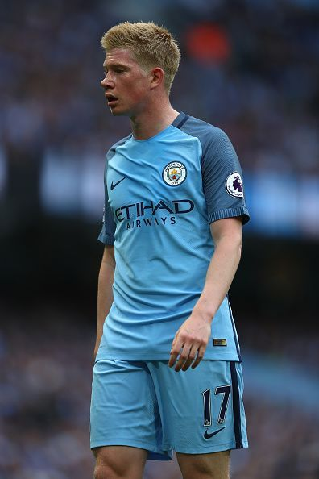
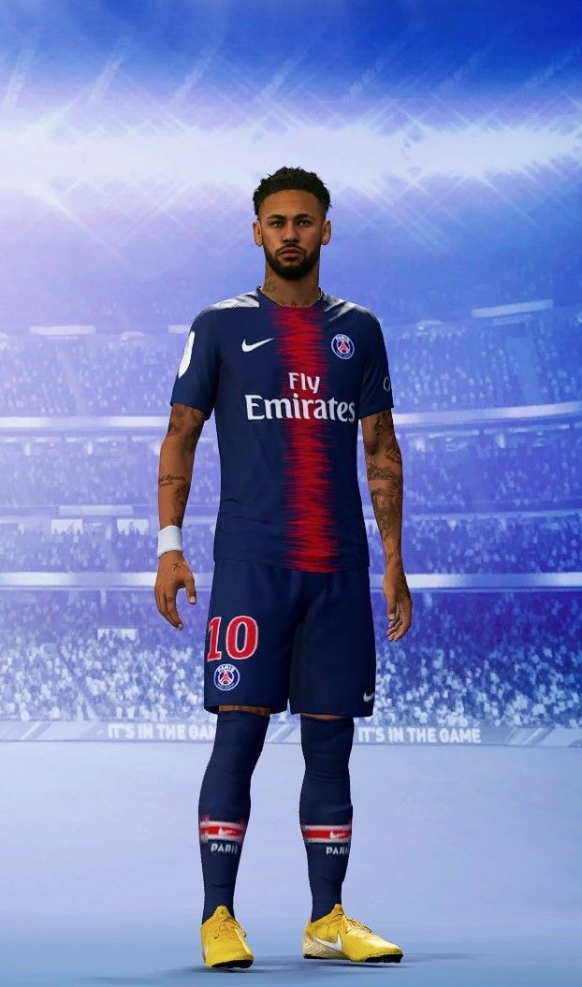
Project Insights
Insights: These outliers are shown above. Players like Lionel Messi, Luka Modric, Kevin De Bruyne and Neymar all have weight below 75kg and they are rated over 90.

Slide 13
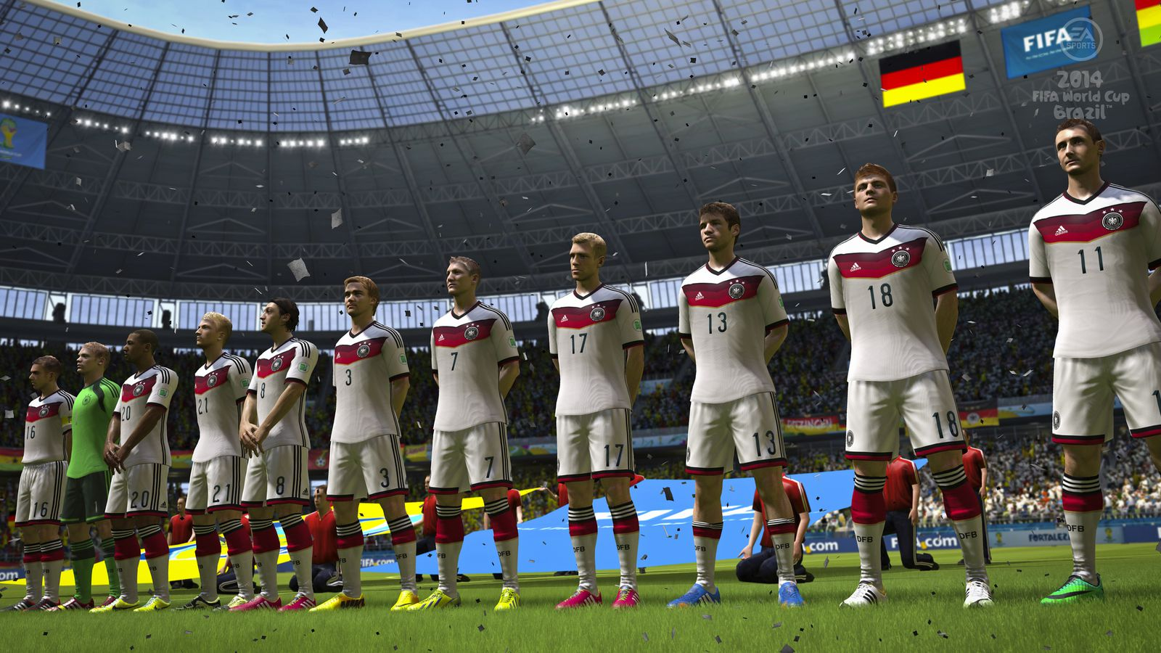
Project Insights
If a Club Manager wants to know whether each player is available to play or not, Display different players based on the continent they are from.

Slide 14
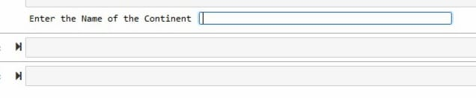
Project Insights
If a Club Manager wants to know whether each player is available to play or not, Display different players based on the continent they are from.
Insights: Players from different continent were filtered and then stored in an application. A club manager can quickly glance through these players for club match availability.

Slide 15
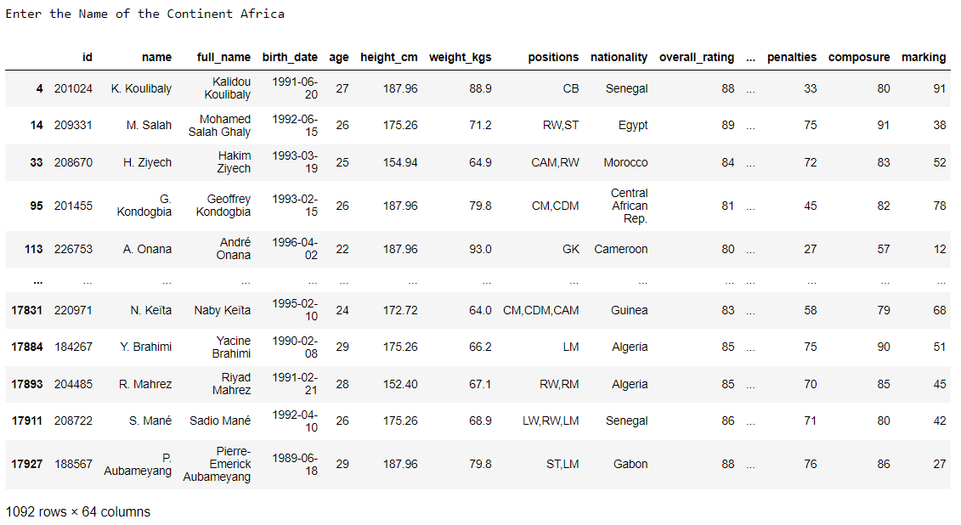
Project Insights

Slide 16
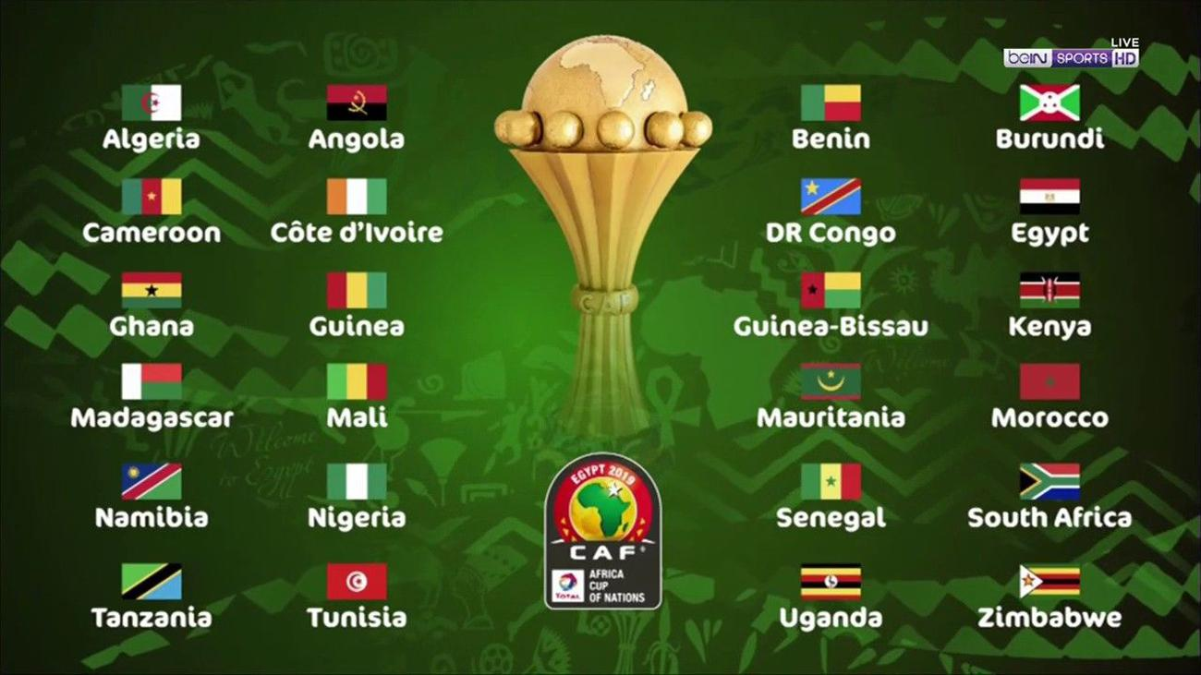
Project Insights
Insights: African players are usually not available for club matches between January and February due to their participation in the African cup of nations tournament.
The club manager can better understand when and how to manage these circumstances during football league campaigns.

Slide 17

End User Benefit
For the Club Managers/Coaches: knowing about the different player ratings, weight and fitness levels will help determine which player to bring to the club and the position that will be suitable for such players on the pitch.
For FIFA Gamers: Understanding the player abilities will improve the gamers gameplay.

Slide 18
Challenges
Initially, we faced so many errors because we were working with a large dataset.
We also, faced some challenges trying to figure out the right plotting method to gain meaningful insights as it’s a large dataset.
We faced challenges while sorting the nationality of the players based on the continent they are from, hence we created a temporary application in our python notebook by using ‘if’ functions

Slide 19

Learnings
#Business Part
We learned from the dataset that if a player can play atleast three different forward positions, then its an asset for both the club and manager as they can be rotated into multiple positions.
We learned that a manager could utilize his players to full potential based on their abilities.

Slide 20

Learnings
#Programming Part
We learned how to clean a dataset
We learned how to use graphical representations to gain insights on a dataset
We learned how to use ‘if’ function to create an application.
We learned how to visualize data from a dataset that has a lot of data.

Slide 21
Conclusion
In conclusion, this project has helped us to improve our business thinking by asking the right business questions and using programming skills to answer them.

Slide 22
Thank You !

